Slide 1

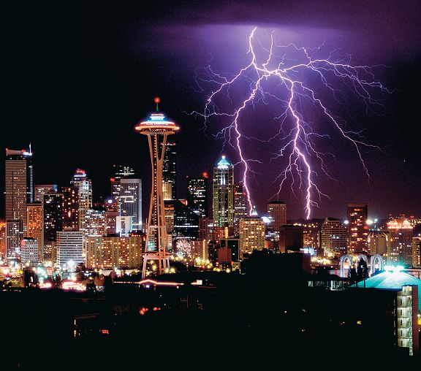
4
Integration
Copyright © Cengage Learning. All rights reserved.

Slide 2
Antiderivatives and Indefinite Integration
4.1
Copyright © Cengage Learning. All rights reserved.

Slide 3
Objectives
Write the general solution of a differential equation.
Use indefinite integral notation for antiderivatives.
Use basic integration rules to find antiderivatives.
Find a particular solution of a differential equation.

Slide 4
Antiderivatives

Slide 5
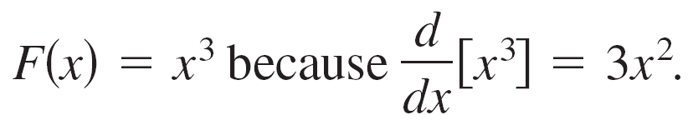
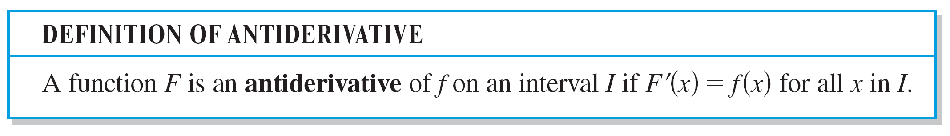
Antiderivatives
Suppose you were asked to find a function F whose
derivative is f(x) = 3x². From your knowledge of derivatives,
you would probably say that
The function F is an antiderivative of f .

Slide 6
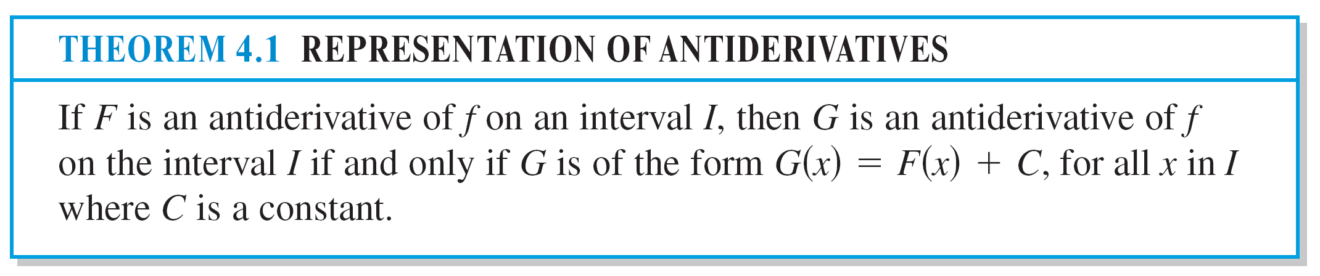
Antiderivatives

Slide 7
Antiderivatives
You can represent the entire family of antiderivatives of a function by adding a constant to a known antiderivative.
For example, knowing that D_{x} [x²] = 2x, you can represent the family of all antiderivatives of f(x) = 2x by
G(x) = x² + C Family of all antiderivatives of f(x) = 2x
where C is a constant. The constant C is called the constant of integration.

Slide 8
Antiderivatives
The family of functions represented by G is the general antiderivative of f, and G(x) = x² + C is the general solution of the differential equation
G'(x) = 2x. Differential equation
A differential equation in x and y is an equation that involves x, y, and derivatives of y.
For instance, y' = 3x and y' = x² + 1 are examples of differential equations.

Slide 9
Example 1 – Solving a Differential Equation
Find the general solution of the differential equation y' = 2.
Solution:
To begin, you need to find a function whose derivative is 2.
One such function is
y = 2x. 2x is an antiderivative of 2.
Now, you can use Theorem 4.1 to conclude that the general solution of the differential equation is
y = 2x + C. General solution

Slide 10
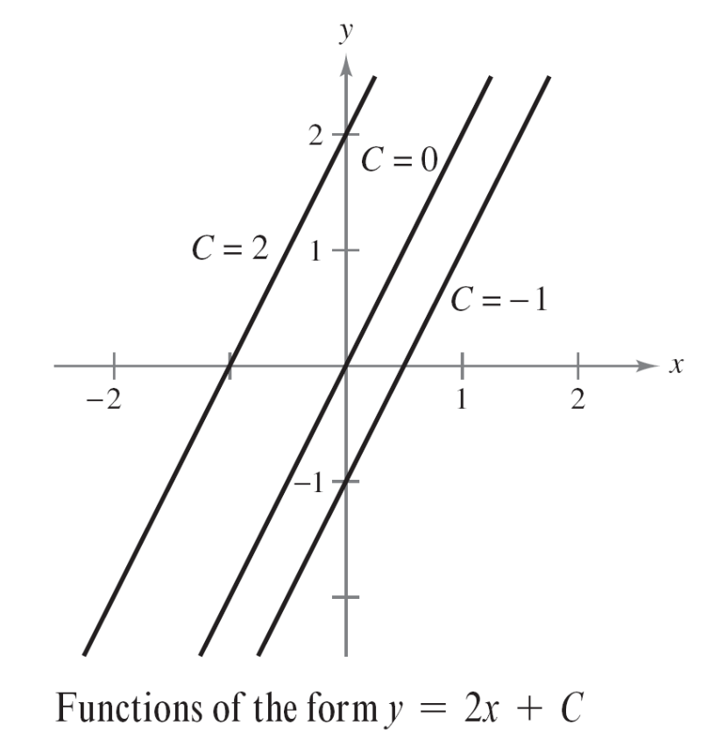
Example 1 – Solution
cont’d
The graphs of several functions of the form y = 2x + C
are shown in Figure 4.1.
Figure 4.1

Slide 11
Notation for Antiderivatives

Slide 12
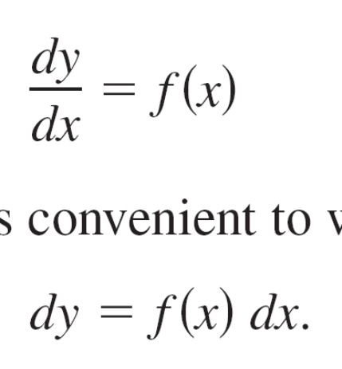
Notation for Antiderivatives
When solving a differential equation of the form
it is convenient to write it in the equivalent differential form
The operation of finding all solutions of this equation is
called antidifferentiation (or indefinite integration) and is
denoted by an integral sign ∫.

Slide 13
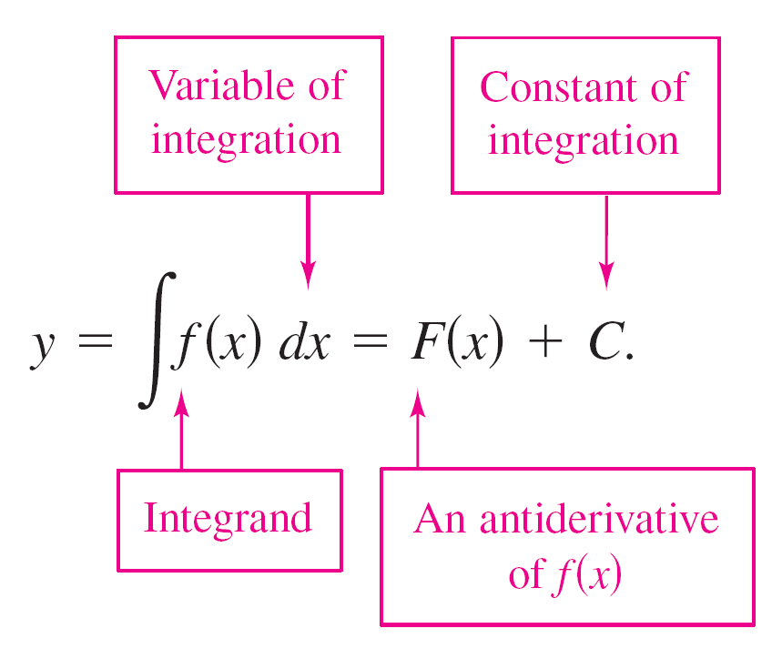
Notation for Antiderivatives
The general solution is denoted by
The expression ∫f(x)dx is read as the antiderivative of f with respect to x. So, the differential dx serves to identify x as the variable of integration. The term indefinite integral is a synonym for antiderivative.

Slide 14
Basic Integration Rules

Slide 15
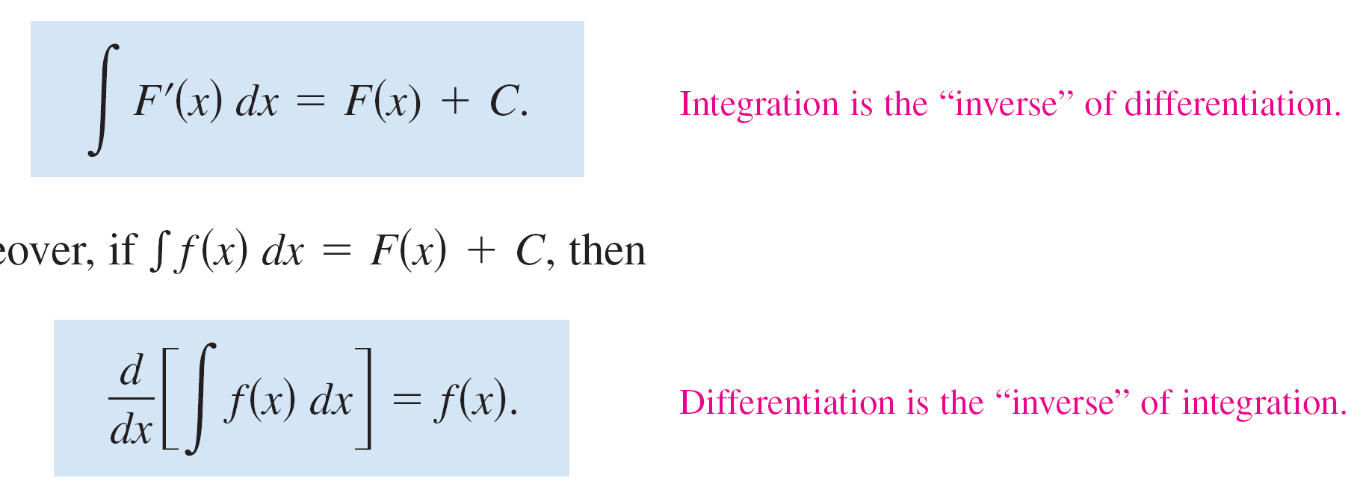
Basic Integration Rules
The inverse nature of integration and differentiation can be verified by substituting F'(x) for f(x) in the indefinite integration definition to obtain
Moreover, if ∫f(x)dx = F(x) + C, then

Slide 16
Basic Integration Rules
These two equations allow you to obtain integration formulas directly from differentiation formulas, as shown in the following summary.

Slide 17
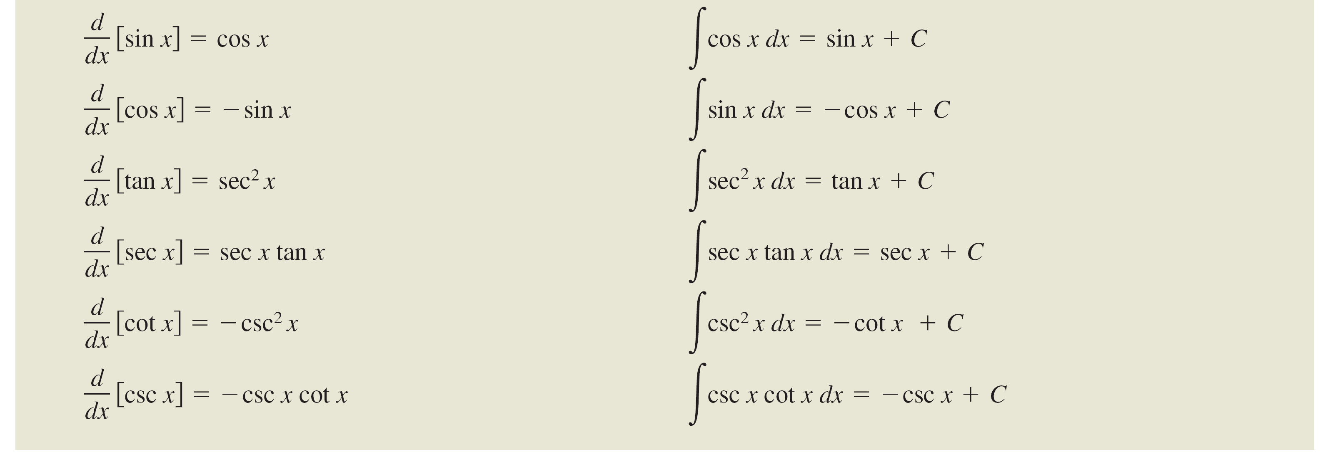
Basic Integration Rules
cont’d

Slide 18
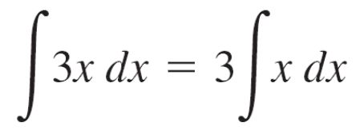

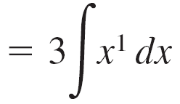

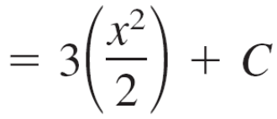

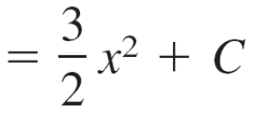

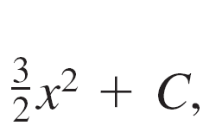
Example 2 – Applying the Basic Integration Rules
Describe the antiderivatives of 3x.
Solution:
So, the antiderivatives of 3x are of the form where C is any constant.

Slide 19
Basic Integration Rules
Note that the general pattern of integration is similar to that of differentiation.

Slide 20
Initial Conditions and Particular Solutions

Slide 21
Initial Conditions and Particular Solutions
You have already seen that the equation y = ∫f(x)dx has
many solutions (each differing from the others by a
constant).
This means that the graphs of any two antiderivatives of f
are vertical translations of each other.

Slide 22
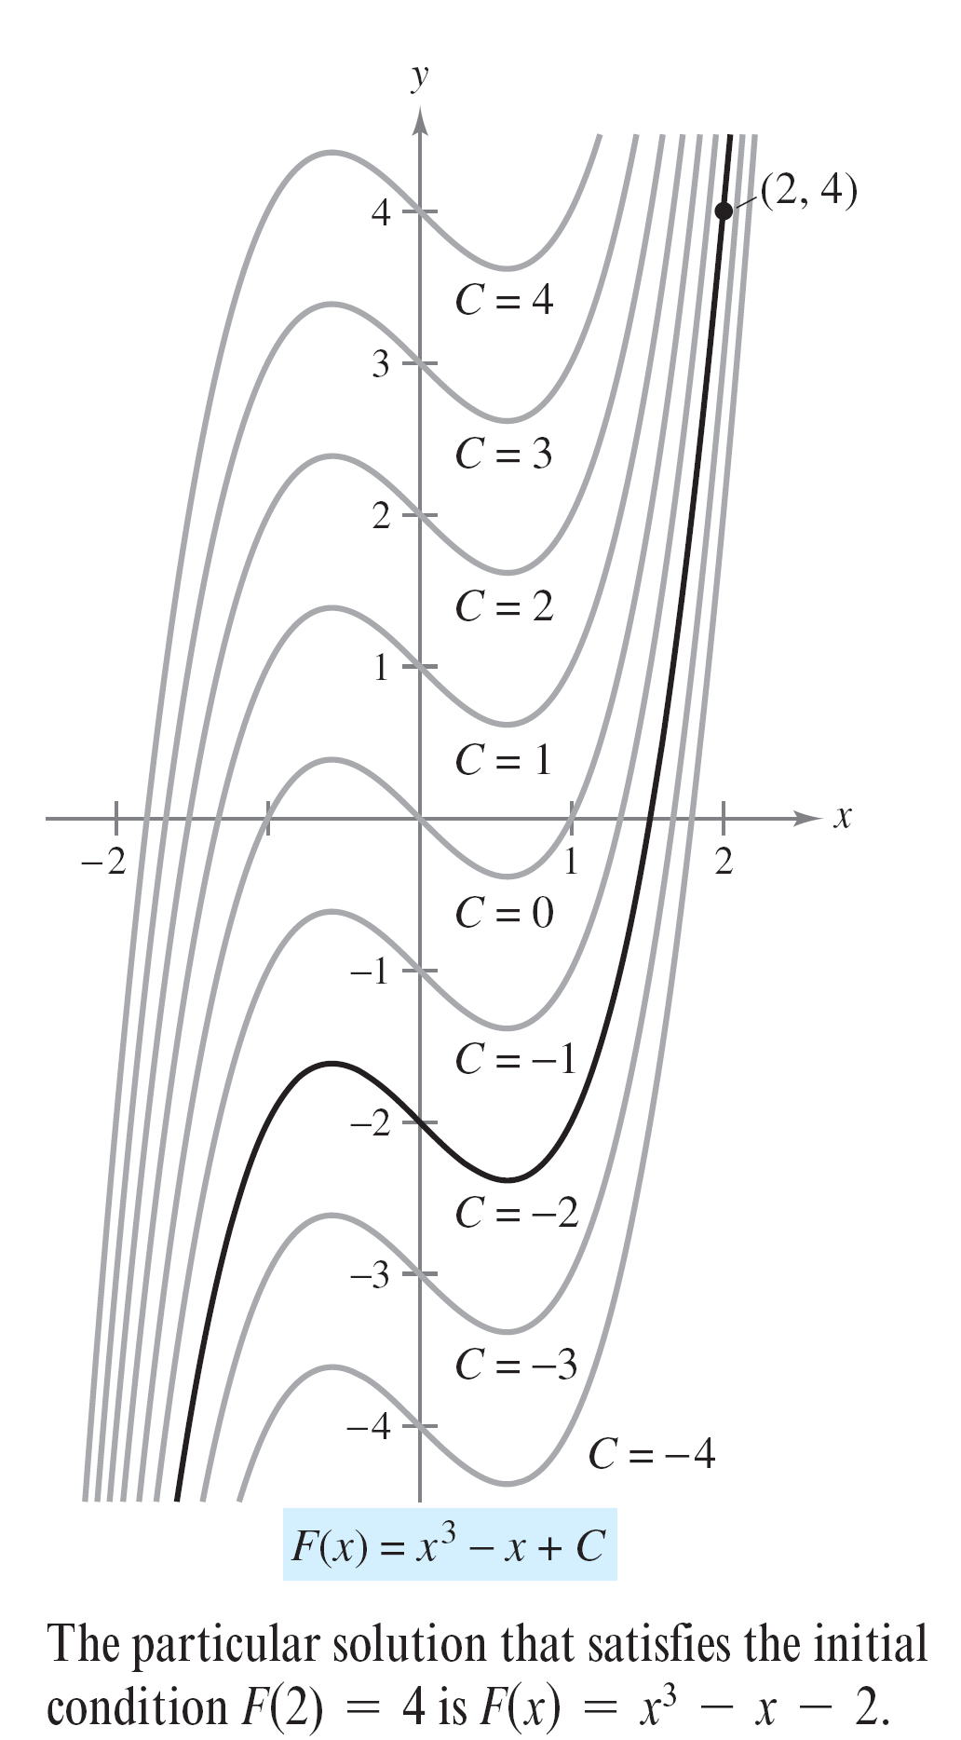
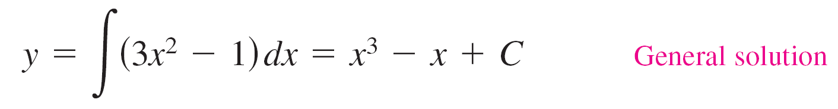
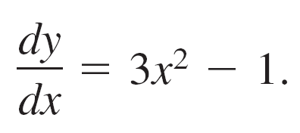
Initial Conditions and Particular Solutions
For example, Figure 4.2 shows the
graphs of several antiderivatives
of the form
for various integer values of C.
Each of these antiderivatives is a solution
of the differential equation
Figure 4.2

Slide 23
Initial Conditions and Particular Solutions
In many applications of integration, you are given enough
information to determine a particular solution. To do this,
you need only know the value of y = F(x) for one value of x.
This information is called an initial condition.
For example, in Figure 4.2, only one curve passes through the point (2, 4).
To find this curve, you can use the following information.
F(x) = x³ – x + C General solution
F(2) = 4 Initial condition

Slide 24
Initial Conditions and Particular Solutions
By using the initial condition in the general solution, you can determine that F(2) = 8 – 2 + C = 4, which implies that C = –2.
So, you obtain
F(x) = x³ – x – 2. Particular solution

Slide 25
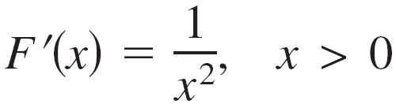
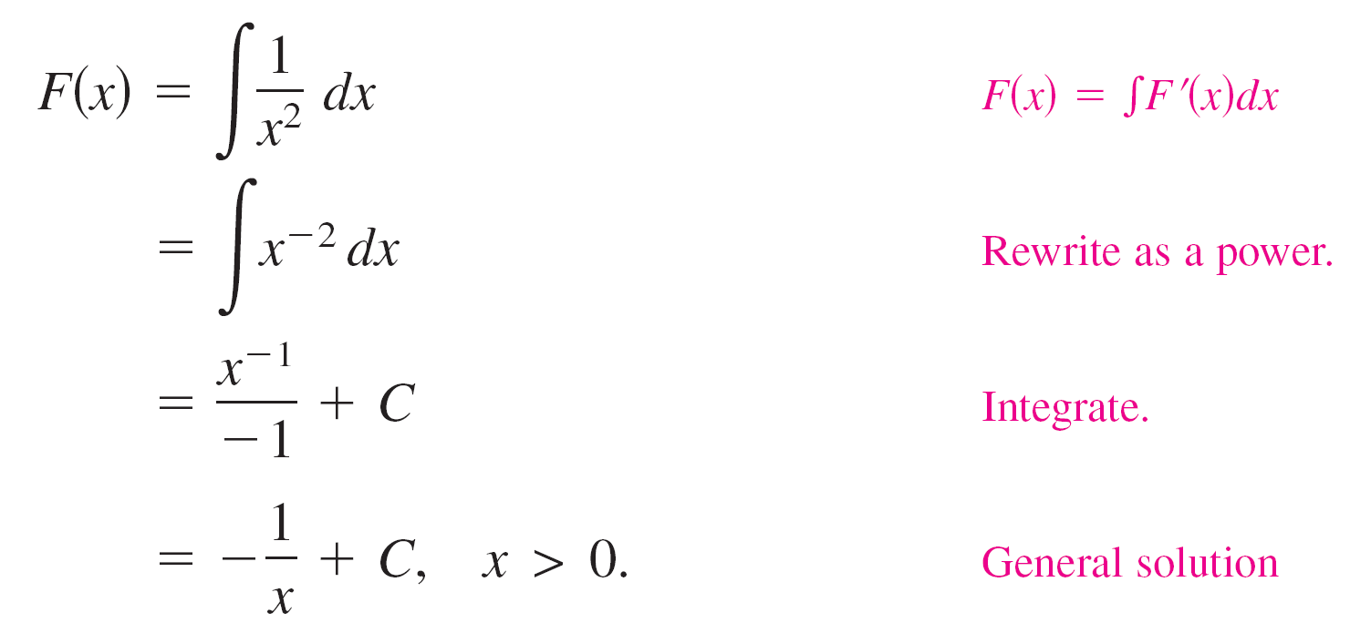
Example 7 – Finding a Particular Solution
Find the general solution of
and find the particular solution that satisfies the initial
condition F(1) = 0.
Solution:
To find the general solution, integrate to obtain

Slide 26
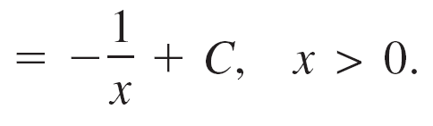

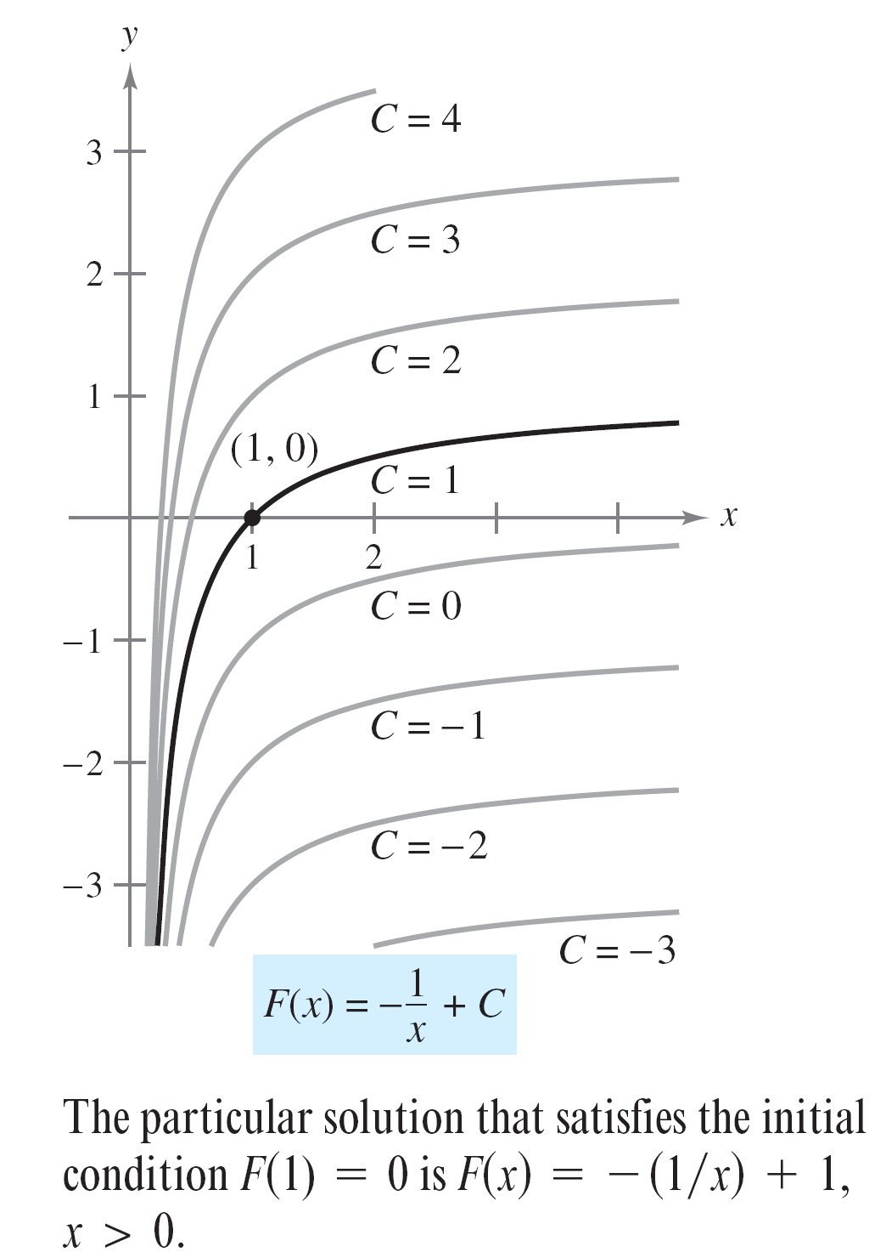
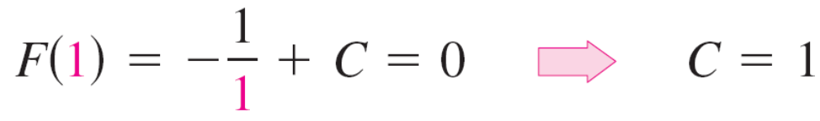
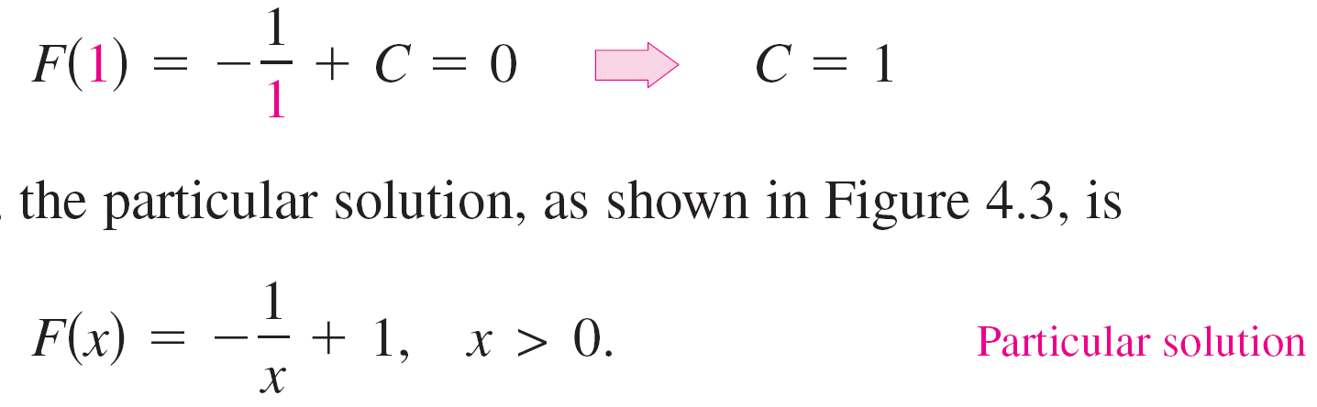
Example 7 – Solution
cont’d
Using the initial condition F(1) = 0, you
can solve for C as follows.
So, the particular solution, as shown
in Figure 4.3, is
Figure 4.3

